Slide 1
RDBMS Monitoring and Tuning

Slide 2
Topics
Common Database Bottlenecks
Oracle Tools:
Oracle Enterprise Manager
Automatic Workload Repository (AWR) Reports
SQL Server:
SQL Server Management Studio Reports
Performance Dashboard
Dynamic Memory Views
SQL Profiler
Database Tuning Advisor

Slide 3
Intro to RDBMS Tuning
Goal in database tuning is to identify and resolve the bottleneck
Common bottlenecks include:
CPU,
Memory for caches and query execution
Disk I/O
Concurrency and locking
MOST bottlenecks are due to poorly executing queries, but sometimes you need a little more…

Slide 4
Common Bottlenecks
CPU-Bound Databases
CPU utilization > 80%, high processor queue length
CPU consumption increases when:
Queries perform lots of logical I/O
Query plans need to be regenerated with each execution (hard parse)
Queries perform large sorts or filters
Memory-Bound Databases
If cache hit ratio is low, then not enough memory has been allocated to the database
Caches
Data pages or blocks are cached in memory
A cache miss forces physical I/O to be performed
Compiled execution plans are also cached
A cache miss forces recompilation and query plan generation (high CPU cost)
If caches are too small, then pages will get aged out too often
Per-session work areas
Where SQL statements are executed

Slide 5
Oracle Memory Structures
SGA – System Global Area
Composed of:
Database buffer cache
Redo log buffer
Shared pool
Large pool
Java pool
Streams pool
Size controlled by “sga_target” and “sga_max_size” parameters
Verify adequate allocation with v$sga_target_advice
“db_block_buffers” and “shared_pool_size” may also be specified to ensure a fixed allocation
PGA – Program Global Area
Composed of:
Session memory
Private SQL Area
Cursors
SQL Work Area
Sorts (order by, group by etc)
Hash joins
Bitmap merges
Size controlled by “pga_aggregate_target” parameter
Verify adequate allocation with v$pga_target_advice
11g adds “Automatic Memory Management” to dynamically size all areas
Controlled by memory_target and memory_max_target
Defining db_cache_size, shared_pool_size etc. will define the minimum amount of memory that should be allocated to those structures
Be sure not to over-allocate and starve the OS!

Slide 6
SQL Server
Automatically manages memory components
Buffer cache
Query plan cache etc.
Memory allocation defined by “min server memory” and “max server memory”
Memory allocated as needed up to “max server memory”
Memory released when OS reports that memory is low

Slide 7
Common Bottlenecks (ctd)
I/O-Bound Databases
Too many physical reads, or slow I/O from the disk subsystem result in poor application performance
Transaction logs and temporary work areas are heavy I/O users
Increased I/O be caused by poorly tuned queries, heavy commits
Locking and Latches
Performance is impacted when sessions have to wait for a shared resource to become available
Latches
Provide exclusive access to internal structures
Protect resources that are needed for a very brief period
If latch cannot be obtained, process will try again later (wait)
Locks
Allow serialized access to resources (rows, buffer blocks, etc)
Can be shared or exclusive
Protect resources needed for a longer time
If lock cannot be obtained, process will wait its turn

Slide 8
Oracle – Monitoring and Tuning the Database
Oracle Enterprise Manager
Automatic Workload Repository
Configuration recommendations

Slide 9
Oracle Enterprise Manager
Out of the box administration tool
Most customers use a 3rd party Database Monitoring Tool
Limited capabilities for non-DBA users
Default URL is https://hostname:1158/em
Allows you to:
View and change object definitions
View and change initialization parameters
Monitor performance
Trigger ASH (Automated Session History), ADDM (Automatic Database Diagnostic Monitoring) and AWR (Automatic Workload Repository) reports
And much more!

Slide 10
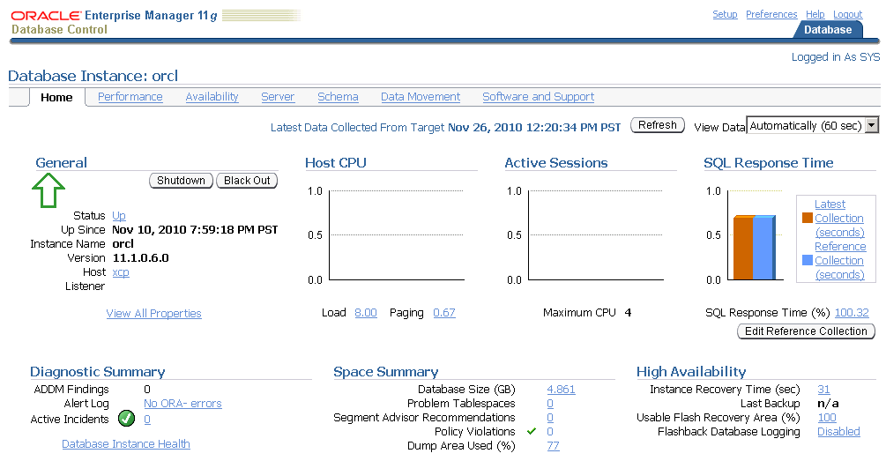
Oracle Enterprise Manager - Home

Slide 11
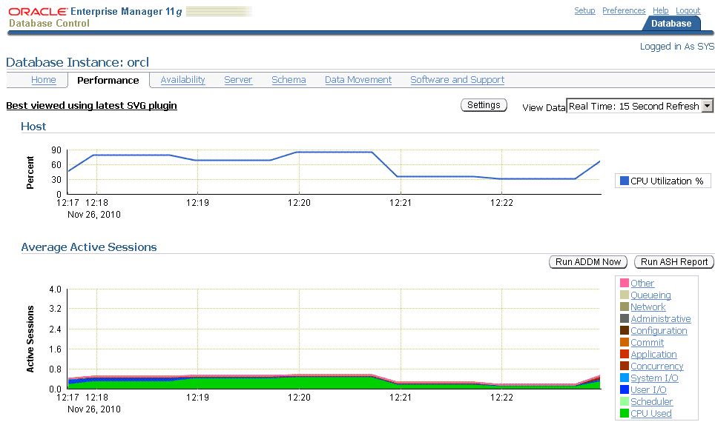
Oracle Enterprise Manager - Performance

Slide 12
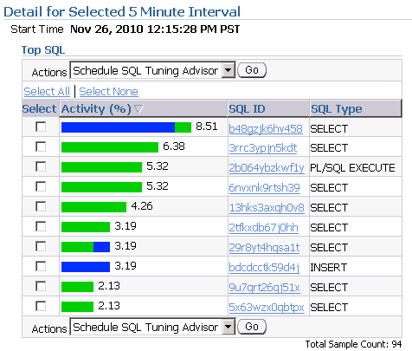
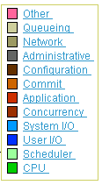
Oracle Enterprise Manager - Top Activity

Slide 13
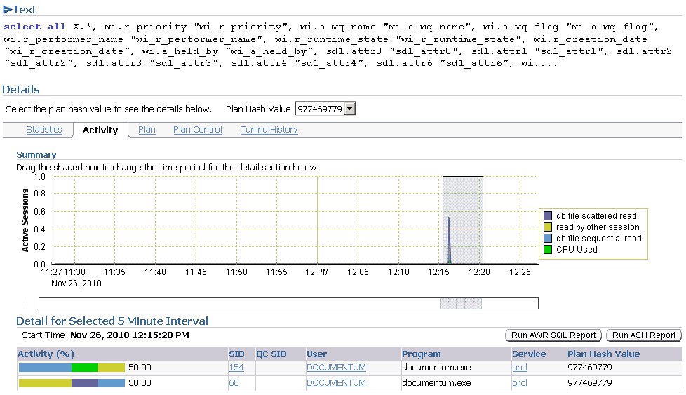
Oracle Enterprise Manager – Statement Details

Slide 14
Automatic Workload Repository
Collects snapshots of system-wide performance statistics including Active Session History (ASH) data
By default, snapshots are taken every hour and retained for 7 days
Snapshots can be taken manually as well
exec dbms_workload_repository.create_snapshot;
Reports can be generated for specific intervals of time
@?/rdbms/admin/awrrpt
Reports can be created to compare two different intervals
@?/rdbms/admin/awrddrpt

Slide 15
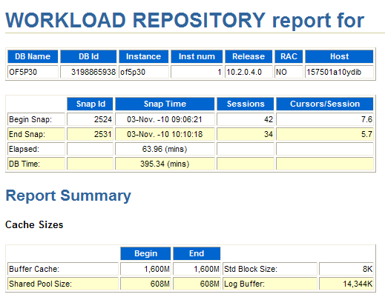
Sample AWR Report
Elapsed time should cover a representative timeframe where performance issues are experienced
Relation of “elapsed” vs. “DB time” give an indication of how hard the database engine is working

Slide 16
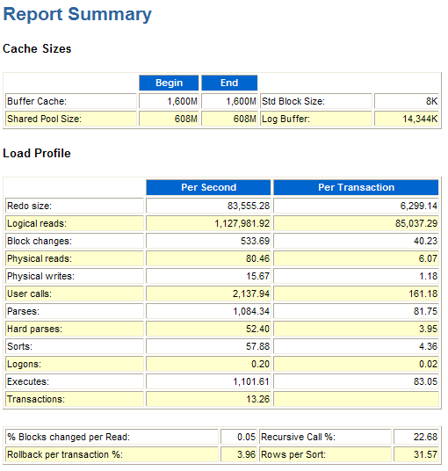
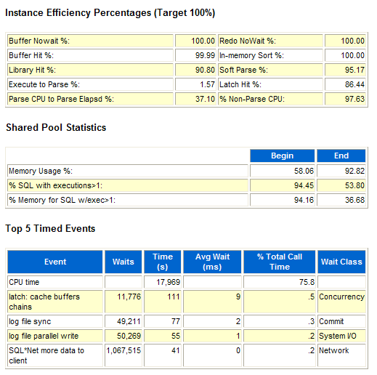
AWR Summary Data
↓

↓
↓

Slide 17
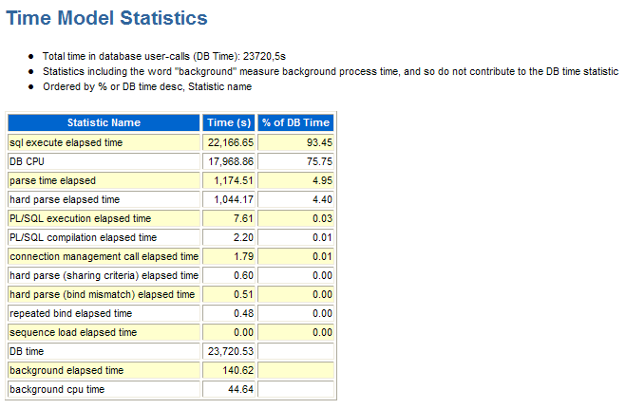
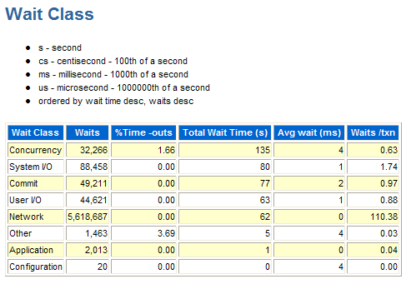
Time Model and Wait Class



Slide 18
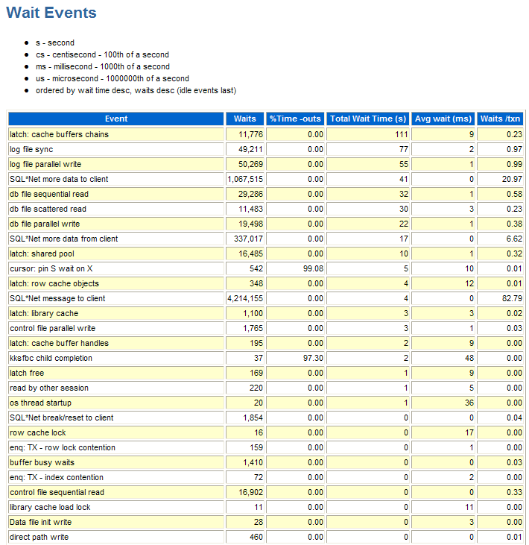
Wait Events
→

Slide 19
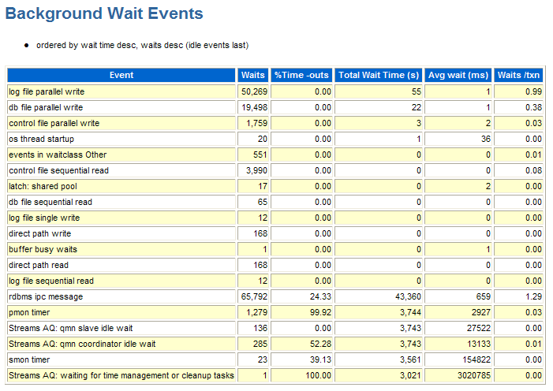
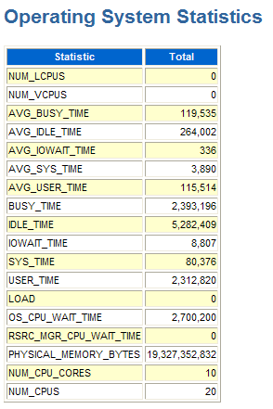
Background Waits and OS Statistics
←
←

Slide 20
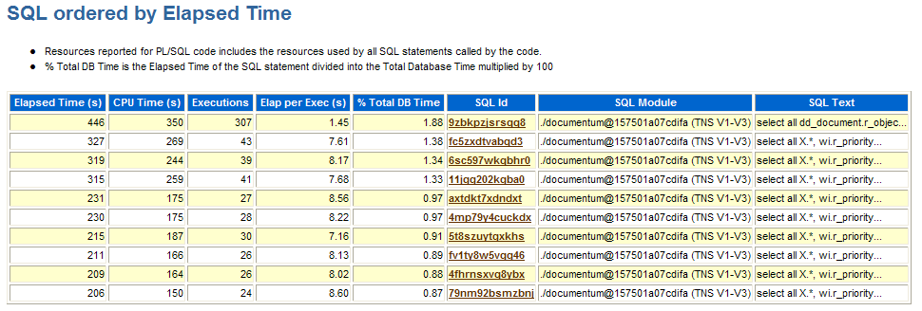
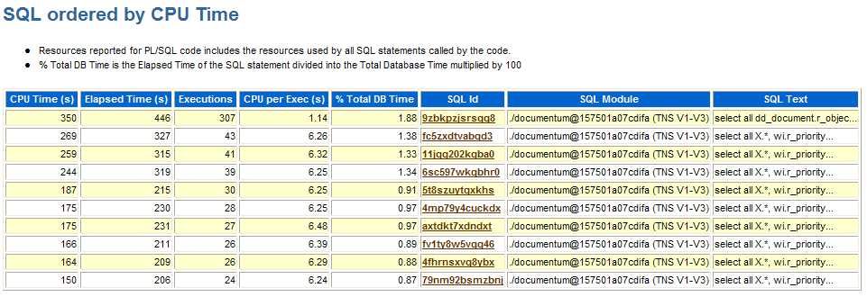
↓
↓

Slide 21
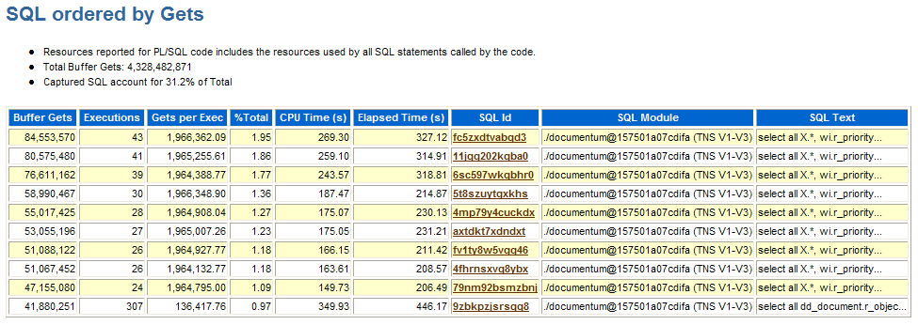
SQL Ordered by Gets
↓

Slide 22
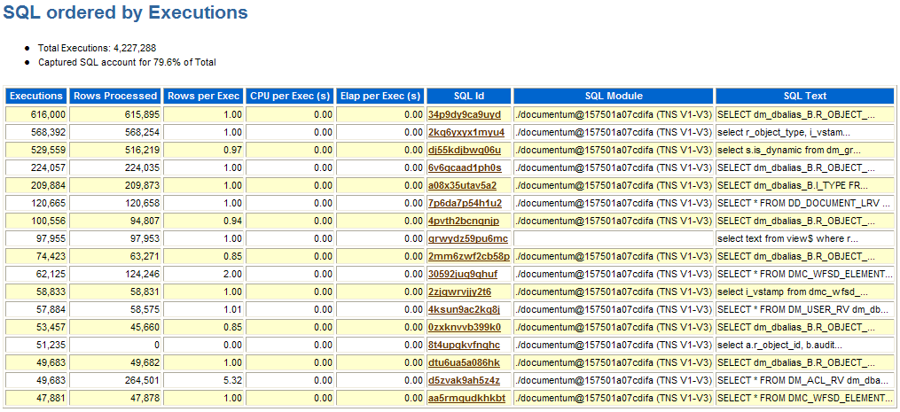
SQL Ordered by Executions
↓

Slide 23
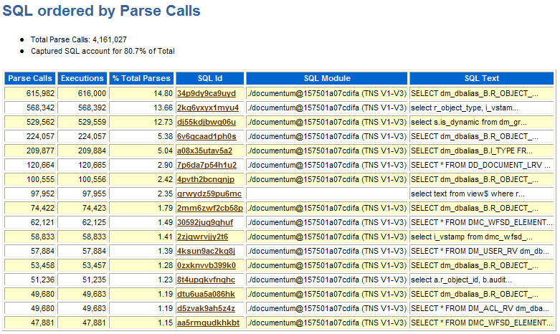
SQL Ordered by Parse Calls
↓

Slide 24
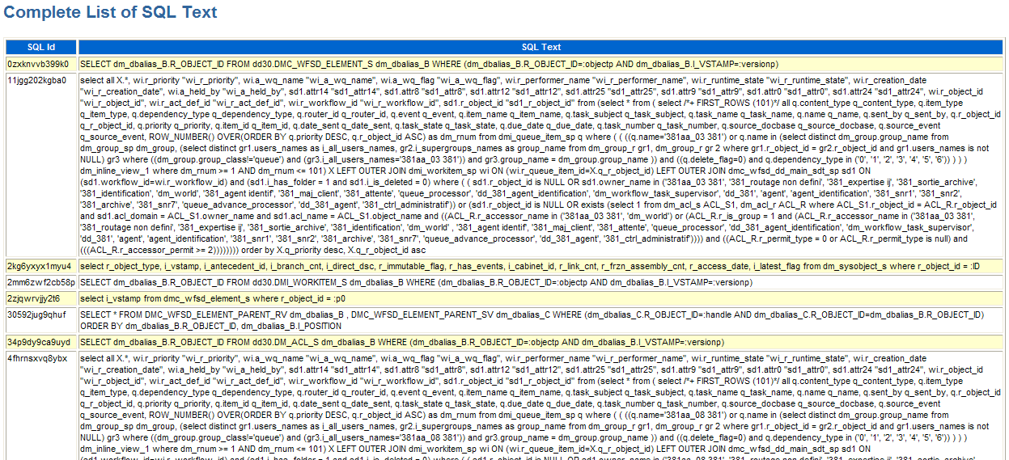
To get the execution plan:
SQL> set linesize 132
SQL> spool 11jgg202kgba0_plan.out
SQL> select * from table(dbms_xplan.display_awr('11jgg202kgba0'));
SQL> spool off

Slide 25
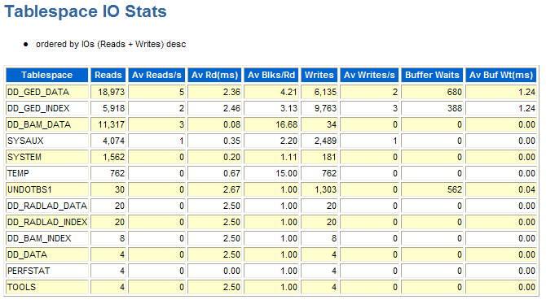
Tablespace IO Statistics
→

Slide 26
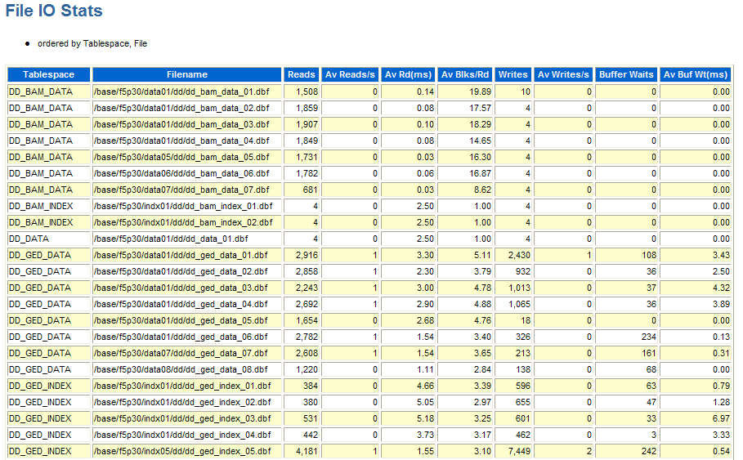
File IO Statistics
↓

Slide 27
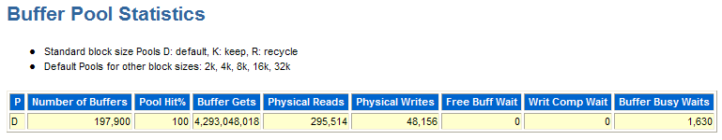
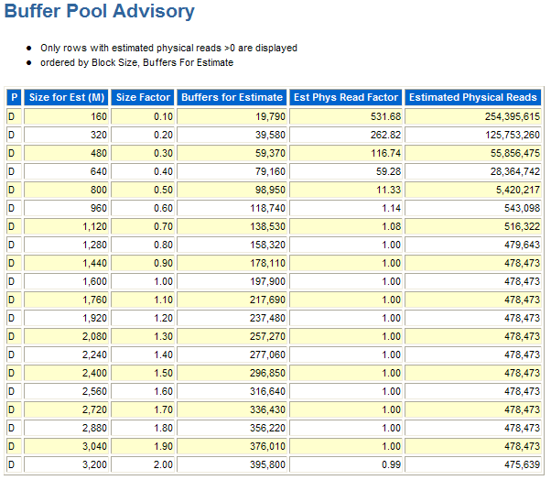
Buffer Pool Statistics and Advisory
↓
→

Slide 28
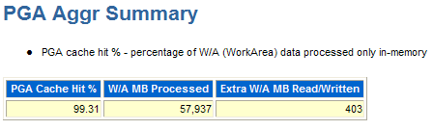
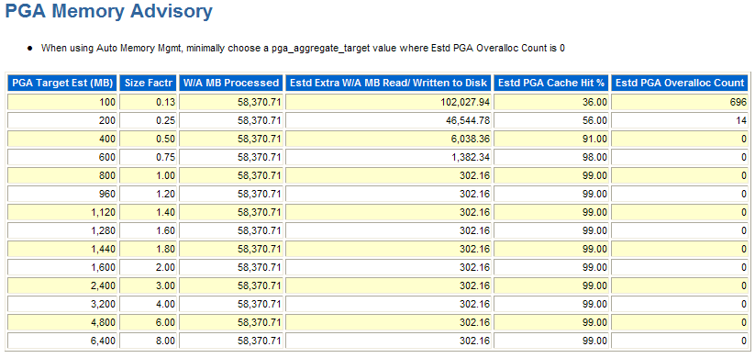
PGA Aggregate Target Stats and Advisory
↓
→

Slide 29
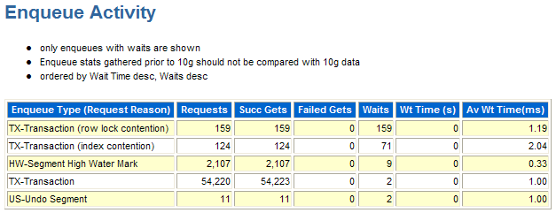
Enqueue Wait Details
↓

Slide 30
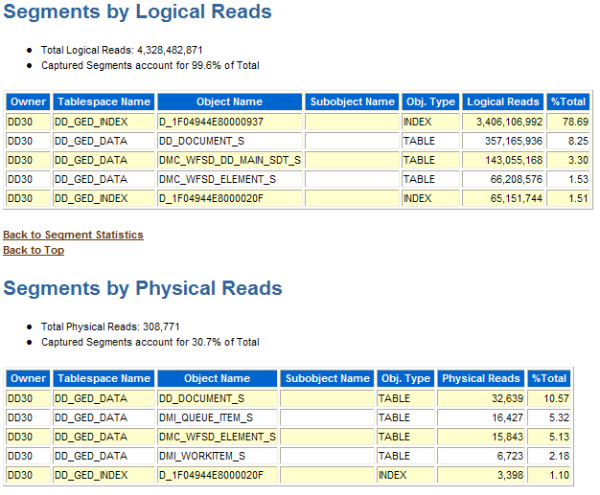
Segments by Logical and Physical Reads

Slide 31
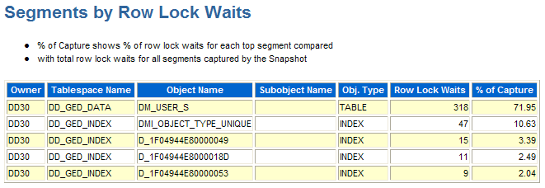
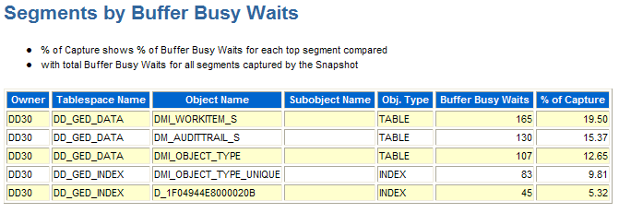
Row Lock Waits and Buffer Busy Waits

Slide 32
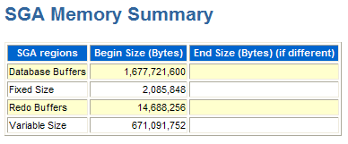
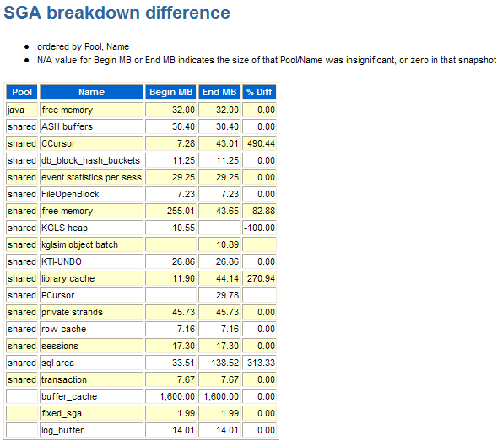
SGA Summary and Size Diffs

Slide 33
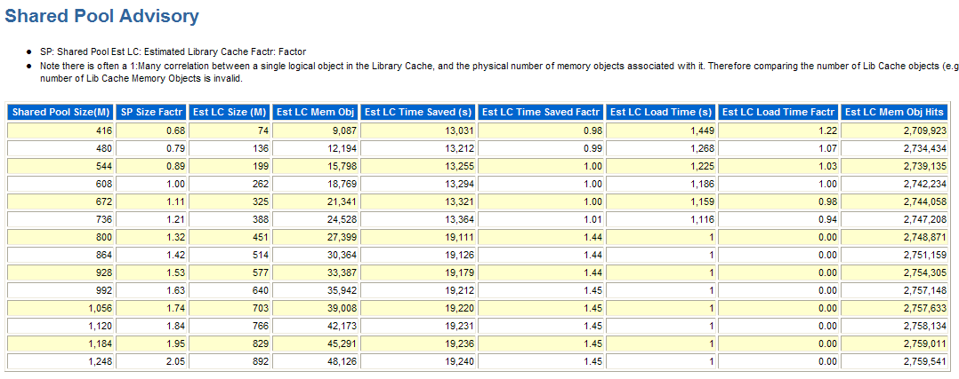
Shared Pool Advisory

Slide 34
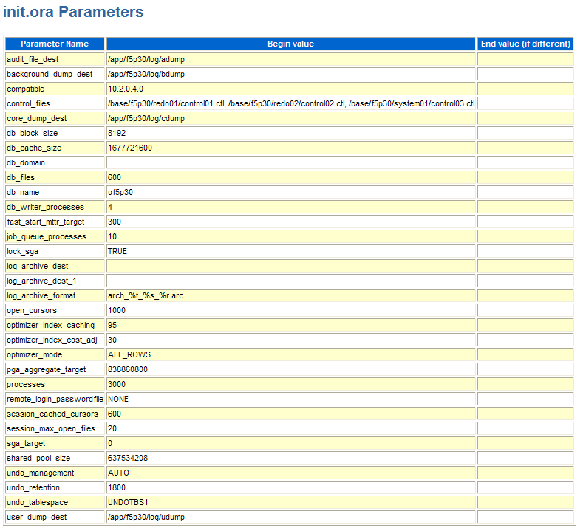

Slide 35
Other Logs Worth Investigating
The database log (or “alert log”) can be helpful to identify:
Errors that might impact performance
Frequency of log switches
Listener logs on the database server can help identify connection issues between the content server(s) and Oracle
Note that these files grow to be very large and should be pruned as performance can be impacted
SQL*Net logs on the content server(s)
Also show issues with connectivity from a client perspective
Generally found at $DM_HOME/bin/sqlnet.log

Slide 36
Configuration Recommendations
10g:
SGA_TARGET and SGA_MAX_SIZE
Set as large as possible, up to a max of 65% of available physical memory
Use v$sga_target_advice to determine whether SGA size can be reduced
PGA_AGGREGATE_TARGET
Each session gets to use a max of 5% of the allocated size, up to a maximum of 100Mb
Set as large as possible, up to a max of 15% of available physical memory
Use v$pga_target_advice to determine whether PGA
11g:
MEMORY_TARGET
Set to total amount of memory you want to allocate to Oracle, up to 80% of the available memory

Slide 37
Configuration Recommendations
CURSOR_SHARING
Whether Oracle should parameterize literals in SQL statements to enable plan reuse
Default is EXACT
We prefer FORCE over SIMILAR
OPTIMIZER_INDEX_COST_ADJ
Relative cost of index access over table scans
Default value is 100
Often (but not always) see better results when set to 5 or 10
OPTIMIZER_INDEX_CACHING
The percentage of index blocks that the optimizer should expect to find in the cache
Default value is 0
Often (but not always) see better results when set to 90 or 95
YOUR MILEAGE MAY VARY!

Slide 38
Where are we?
Common Database Bottlenecks
Oracle Tools:
Oracle Enterprise Manager
Automatic Workload Repository (AWR) Reports
SQL Server:
SQL Server Management Studio Reports
Performance Dashboard
Dynamic Memory Views
SQL Profiler
Database Tuning Advisor

Slide 39
SQL Server – Monitoring and Tuning the Database
SQL Server Management Studio
Canned reports
Performance dashboard
Dynamic Management Views (DMVs)
Configuration recommendations

Slide 40
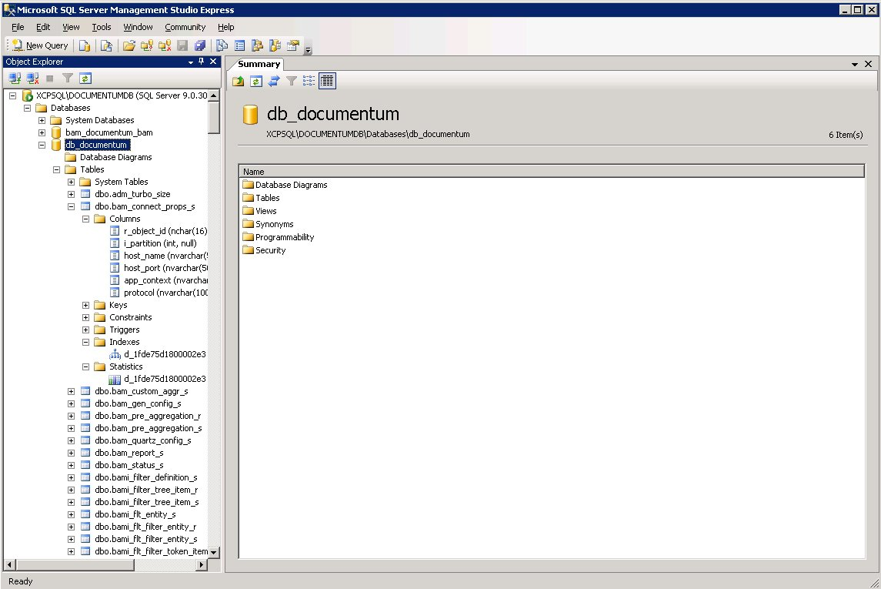
SQL Server Management Studio

Slide 41
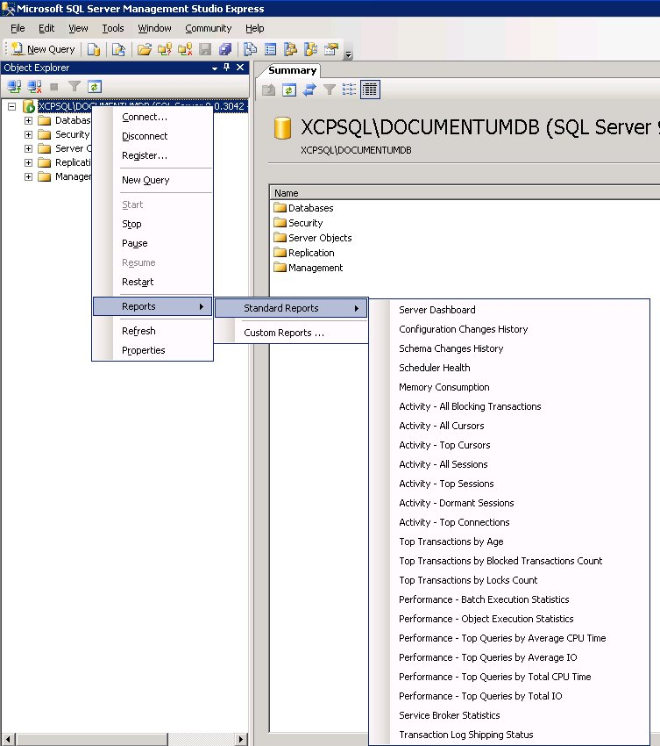
Server-level Reports
Provides a great overview of the instance usage
Default reports available for:
Instance activity
Top sessions and queries
Memory utilization
And more!
Reports can be exported to XML or PDF

Slide 42
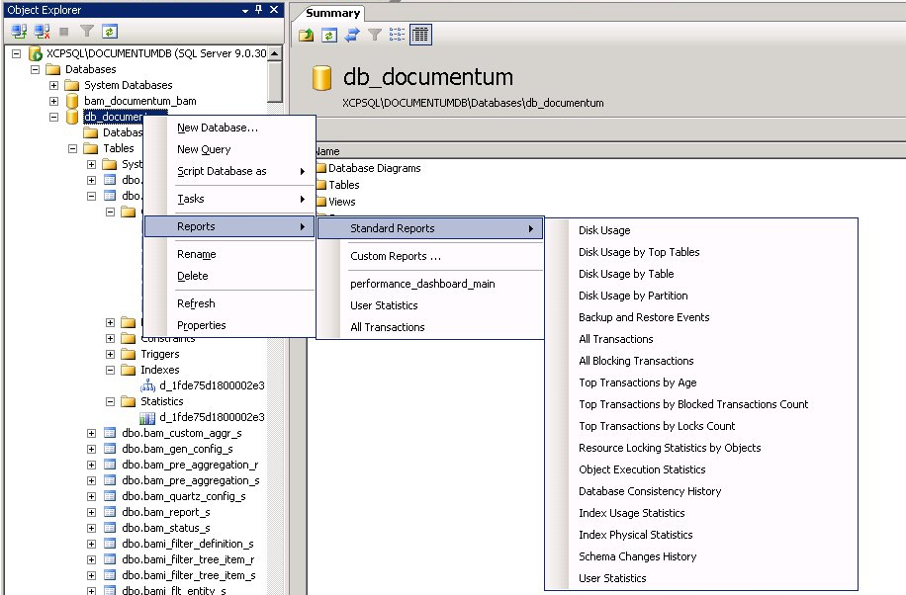
Database Level Reports

Slide 43
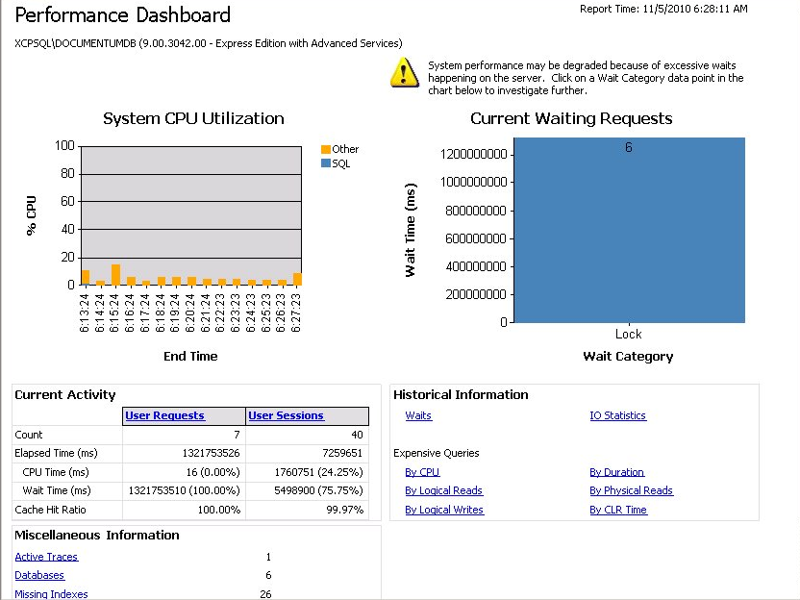
Performance Dashboard
Added as a Custom Report
Download and install separately
Drill-down capability

Slide 44
Performance Dashboard Reports
Blocking
Buffer IO
Buffer Latch
Database Overview
Expensive Queries
Generic Waits
Historical IO
Latch Waits
Missing Indexes
Page Details
Query Plan
Recent CPU Utilization
Requests Overview
Session Details
Sessions Overview
Traces

Slide 45
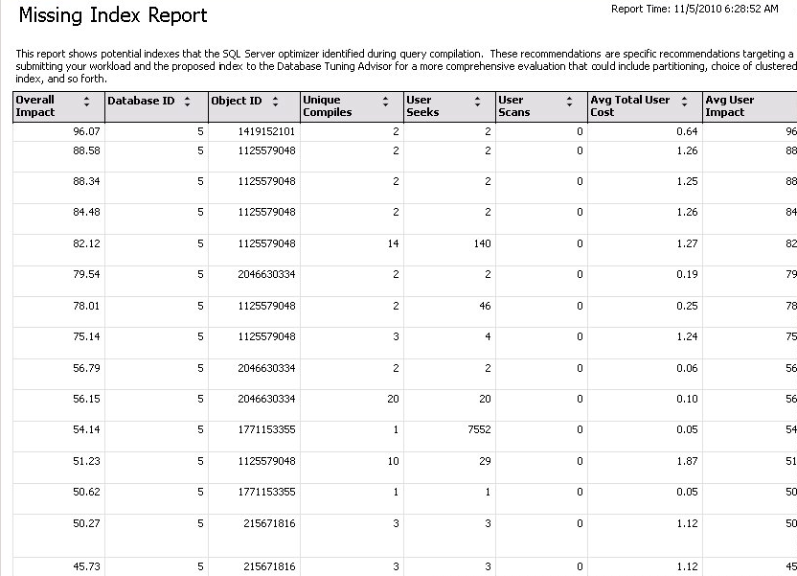
Missing Index Report

Slide 46
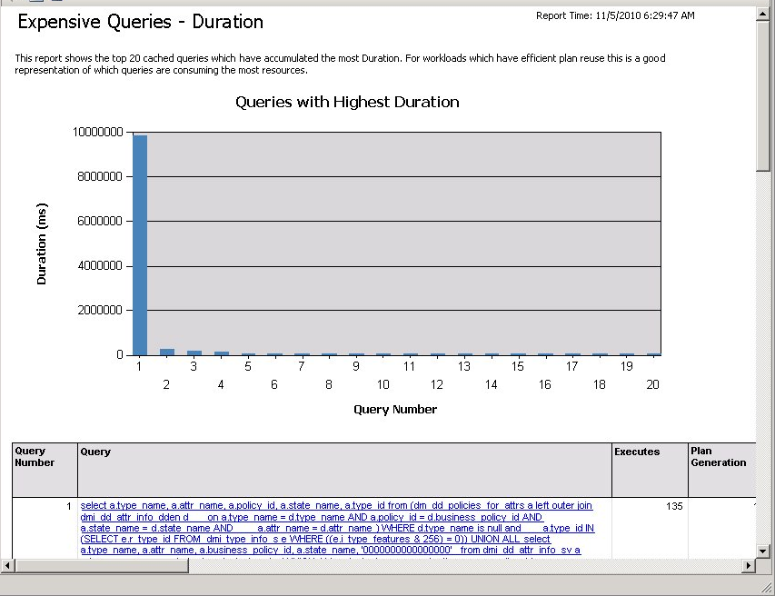
Expensive Queries by Duration
Cumulative summary of query execution time

Slide 47
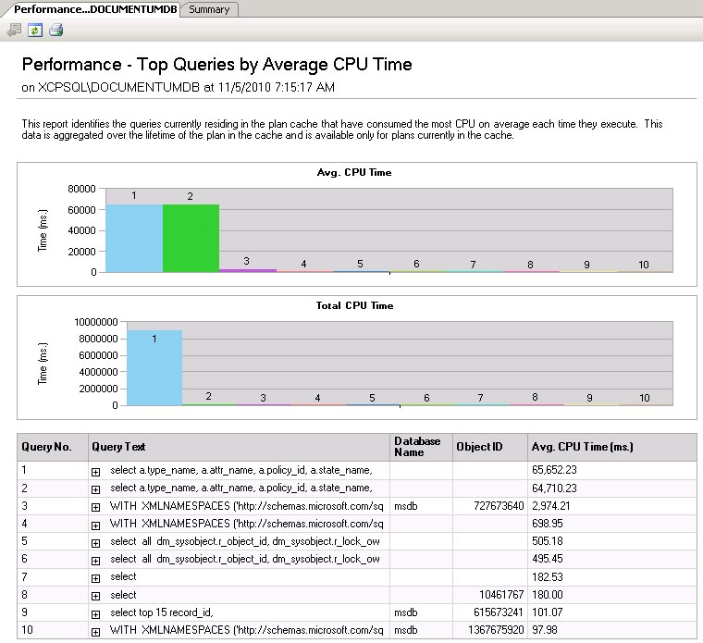
Top Queries by CPU Time

Slide 48
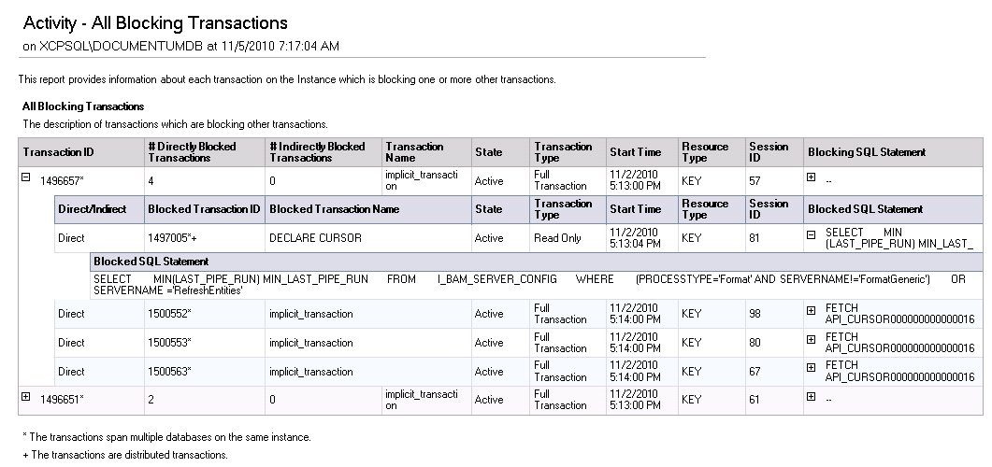
Blocking Transactions

Slide 49
Dynamic Management Views
DMVs allow you to look inside SQL Server to troubleshoot performance problems
5 main categories:
Sys.dm_exec_*
Execution-related views
Sys.dm_os_*
Memory, locks and execution scheduling
Sys.dm_trans_*
Transactions and isolation
Sys.dm_io_*
Report on IO statistics
Sys.dm_db_*
Database-level statistics

Slide 50
DMV Example Queries
List execution statsistics for all queries in the cache:
select * from sys.dm_exec_query_stats
go
List execution statistics AND query test for all queries in the cache:
select * from sys.dm_exec_query_stats qs
cross apply sys.dm_exec_sql_text(qs.plan_handle)
order by total_logical_reads desc
go

Slide 51
Top Queries
SELECT TOP 20
total_worker_time, total_elapsed_time,
total_worker_time/execution_count AS avg_cpu_cost, execution_count,
(SELECT DB_NAME([dbid]) + ISNULL('..' + OBJECT_NAME(objectid), '') FROM sys.dm_exec_sql_text([sql_handle])) AS query_database,
(SELECT SUBSTRING(est.[text], statement_start_offset/2 + 1,
(CASE WHEN statement_end_offset = -1
THEN LEN(CONVERT(nvarchar(max), est.[text])) * 2
ELSE statement_end_offset
END - statement_start_offset) / 2
)
FROM sys.dm_exec_sql_text([sql_handle]) AS est) AS query_text,
total_logical_reads/execution_count AS avg_logical_reads,
total_logical_writes/execution_count AS avg_logical_writes,
last_worker_time, min_worker_time, max_worker_time,
last_elapsed_time, min_elapsed_time, max_elapsed_time,
plan_generation_num, qp.query_plan
FROM sys.dm_exec_query_stats
OUTER APPLY sys.dm_exec_query_plan([plan_handle]) AS qp
WHERE [dbid] >= 5 AND (total_worker_time/execution_count) > 500
--ORDER BY avg_cpu_cost DESC
--ORDER BY execution_count DESC
ORDER BY total_worker_time DESC
GO

Slide 52
Missing Indexes
SELECT det.database_id, det.object_id,
DB_NAME(det.database_id) as [database_name],
OBJECT_NAME(det.object_id, database_id) AS [object_name],
grp.user_seeks, grp.user_scans,
det.equality_columns, det.inequality_columns,
det.included_columns, det.statement
FROM sys.dm_db_missing_index_details det
INNER JOIN sys.dm_db_missing_index_groups link ON det.index_handle = link.index_handle
LEFT OUTER JOIN sys.dm_db_missing_index_group_stats AS grp ON link.index_group_handle = grp.group_handle
WHERE det.database_id >= 5
ORDER BY [database_name], [object_name]
GO

Slide 53
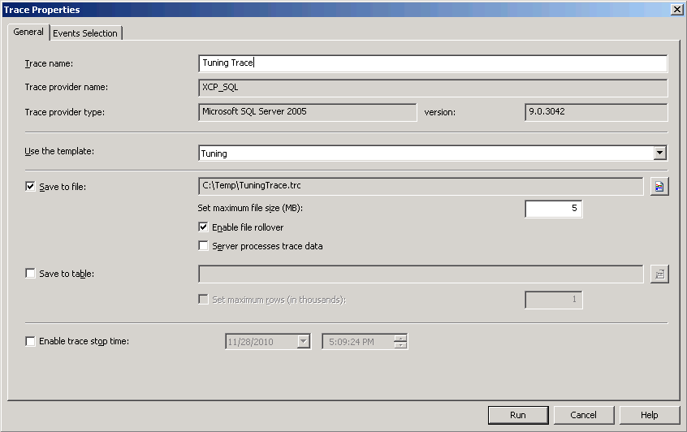
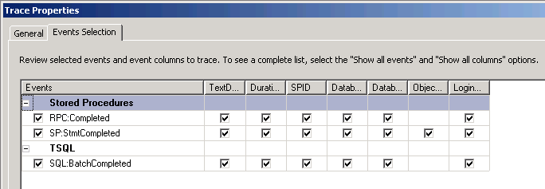
SQL Profiler
Manually define data to collect, or choose a canned profile to select comment events needed to diagnose specific issues.

Slide 54
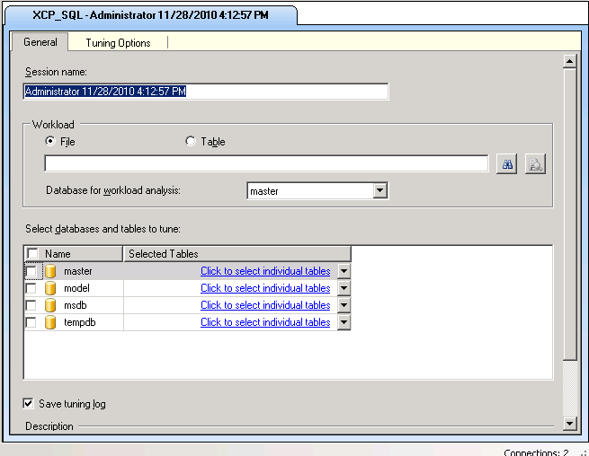
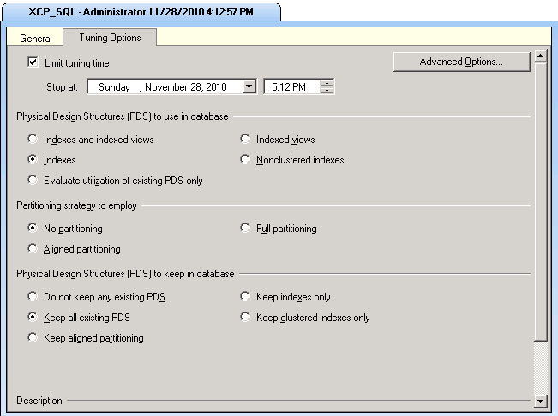
Database Engine Tuning Advisor
Sophisticated tool to analyze real workloads and identify tuning actions that will improve performance
Can recommend Indexes, Indexed Views and Partitioning

Slide 55
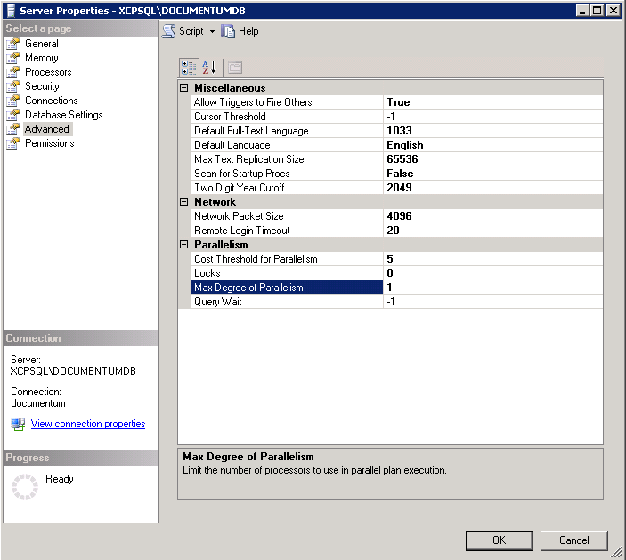
Recommended Server Settings
Server Properties -> Advanced
Max Degree of Parallelism = 1

Slide 56
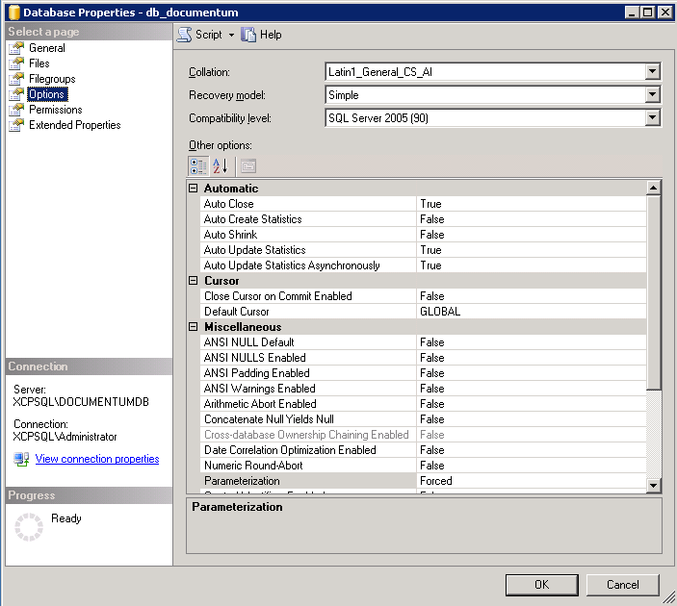
Recommended Database Settings
Database Properties -> Options
Auto Create Statistics = False
Auto Update Statistics = True(*)
Auto Update Statistics Asynchronously = True(*)
Parameterization = Forced
(*) Set to False and manually update statistics if excessive recompilation is observed on the server

Slide 57
Recap
Common Database Bottlenecks
Oracle Tools:
Oracle Enterprise Manager
Automatic Workload Repository (AWR) Reports
SQL Server:
SQL Server Management Studio Reports
Performance Dashboard
Dynamic Memory Views
SQL Profiler
Database Tuning Advisor

Slide 58

Q&A

